Slide 1
Book borrowing system
K.Priyadharshini
22124041

Slide 2
AGENDA
INTRODUCTION
LANGUAGES USED
EXISTING SYSTEM
DRAWBACKS
PROPOSED SYSTEM
ADVANTAGES
DATA FLOW
PROJECT SCREENSHORTS
CONCLUSION

Slide 3
INTRODUCTION
The Book Lending Website is a dynamic platform for exchanging and borrowing books, fostering a vibrant community of book enthusiasts. Users can create secure accounts to upload and manage their book collections with detailed information. Key features include secure registration, intuitive book uploading, and a user-friendly interface for browsing and searching the catalog. The streamlined borrowing process and integrated alert system ensure easy management of book requests and timely notifications. Leveraging modern web technologies, the platform offers a seamless user experience, promoting reading, resource sharing, and community interaction in a secure digital environment.

Slide 4
LANGUAGES USED
Front end
Backend
Html
CSS
JavaScript
Boot strap
My sql
php

Slide 5
EXISTING SYSTEM
In many communities, book lending and borrowing thrive through physical libraries, informal exchanges, and online platforms. Traditional libraries offer curated collections and professional assistance. Social media groups provide personalized recommendations and a sense of community. Online marketplaces present a wider selection and potentially lower costs. These systems connect readers and enhance access to books in unique ways.

Slide 6
DRAWBACKS:
Limited accessibility
Management issues
Communication challenges
Security and trust concerns
Limited community features

Slide 7
PROPOSED SYSTEM
The proposed Book Lending Website revolutionizes book exchanges with a centralized online platform. Users can register, upload their book collections, browse available books, and request to borrow easily. Key features include user authentication, intuitive book management, and timely alert notifications. Leveraging web technologies, the website offers a seamless, user-friendly experience, fostering a vibrant community of book enthusiasts and promoting reading and resource-sharing.

Slide 8
BENEFITS
Wider selection of books
Professional librarian assistance
Potentially lower costs
Personalized recommendations
Cost savings

Slide 9
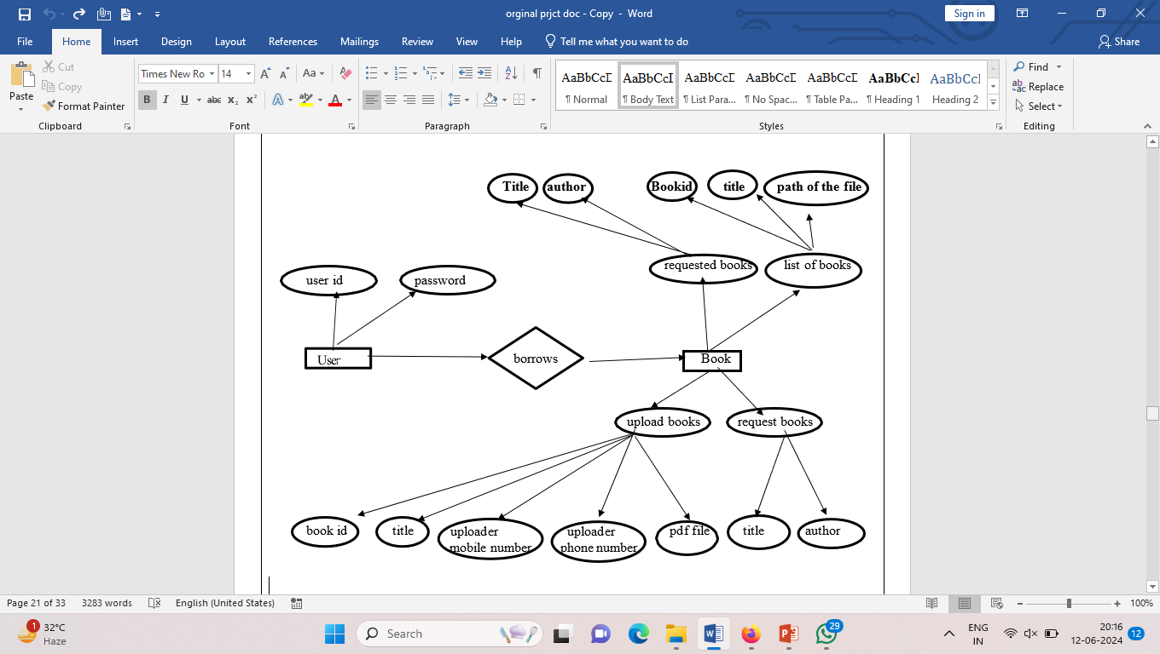
FLOW

Slide 10
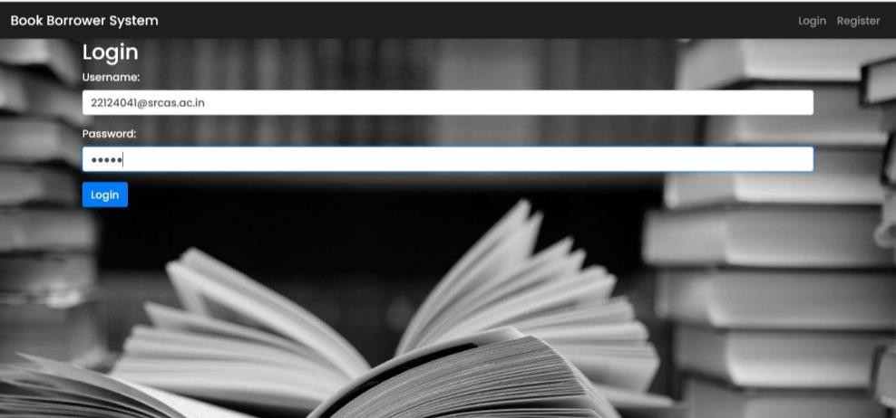
LOGIN PAGE

Slide 11
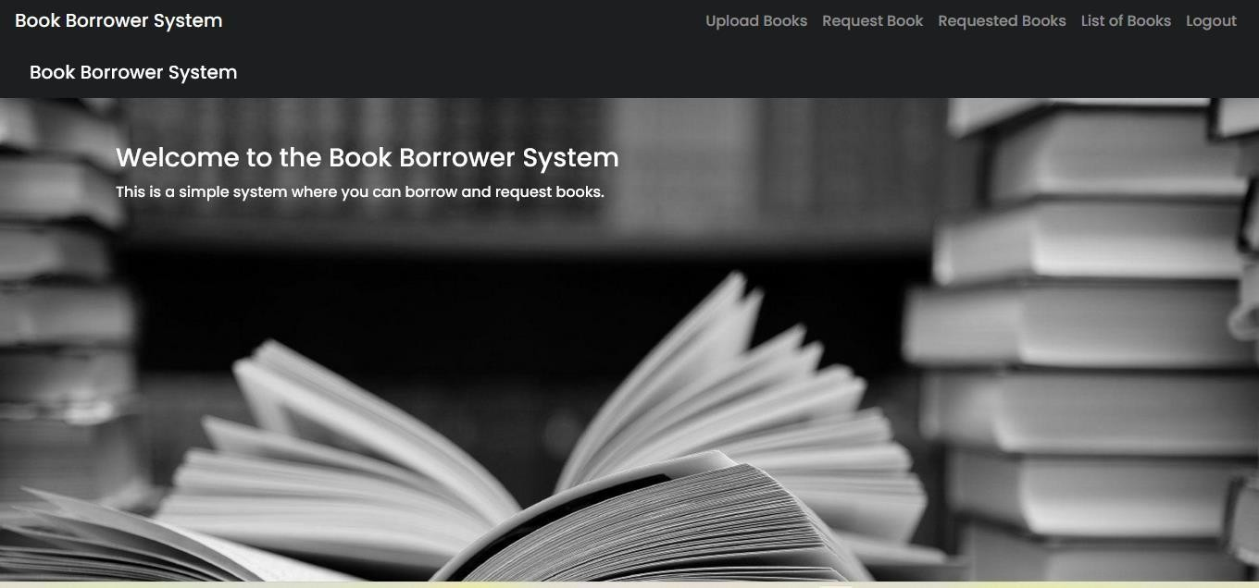
HOME PAGE

Slide 12
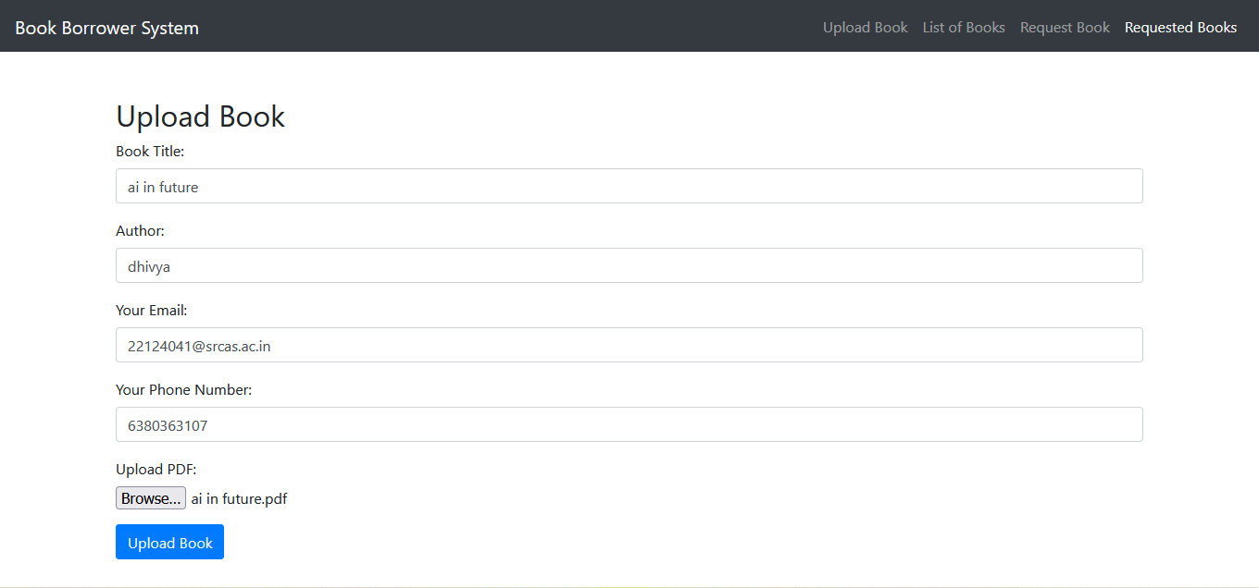
UPLOAD BOOKS

Slide 13
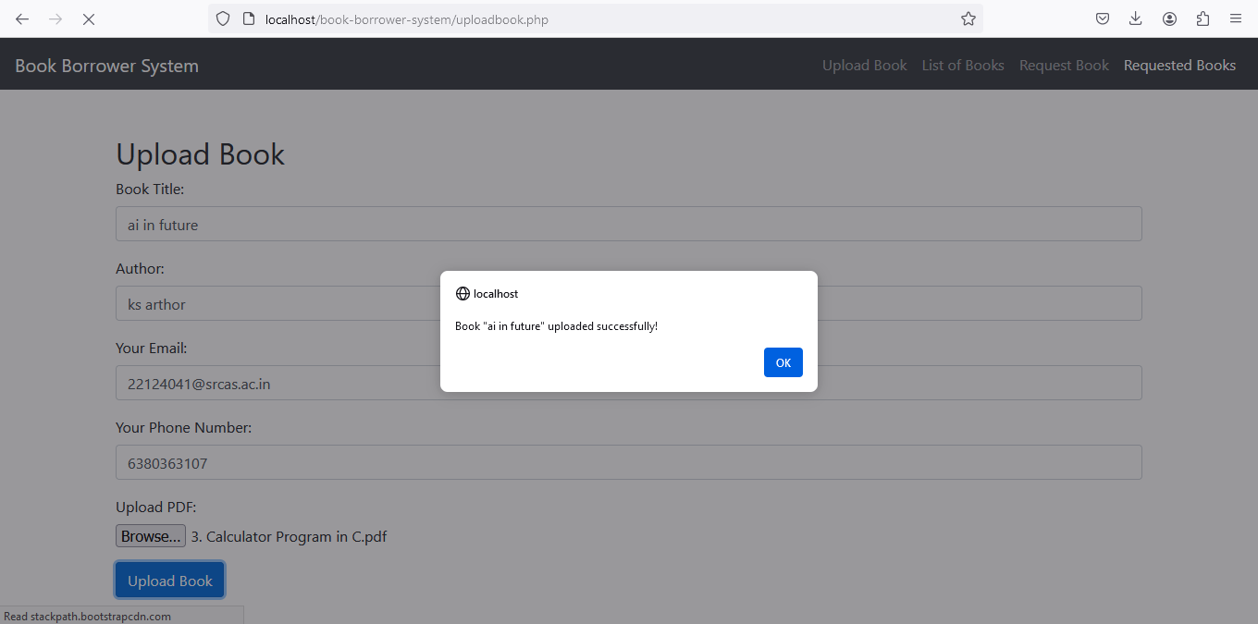
UPLOAD SUCCESSFULL

Slide 14
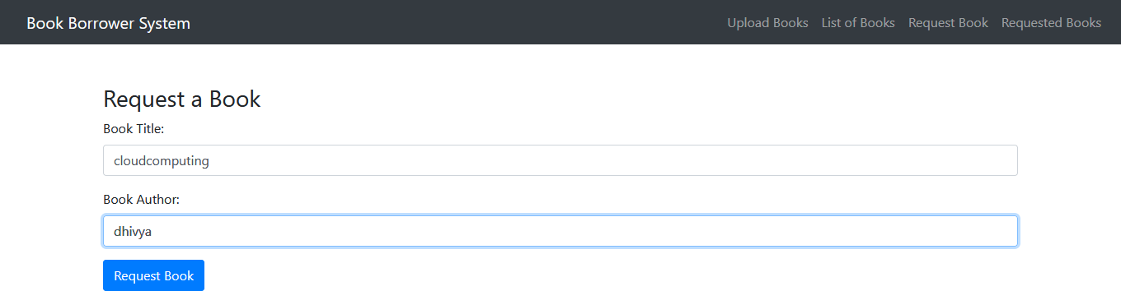
REQUEST BOOK

Slide 15
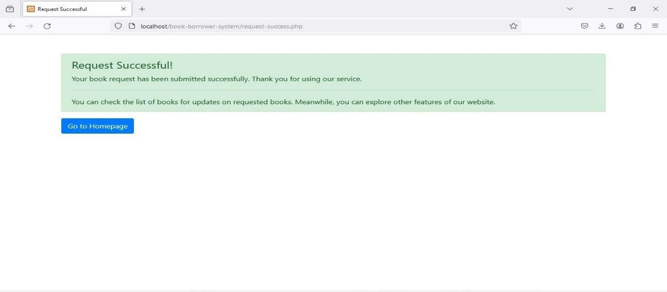
REQUEST SUCCESSFULL

Slide 16
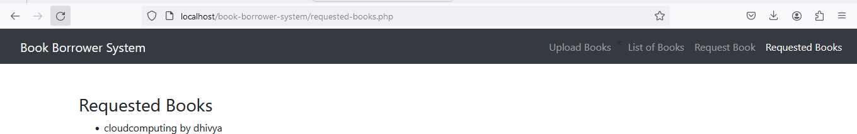
REQUESTED BOOKS

Slide 17
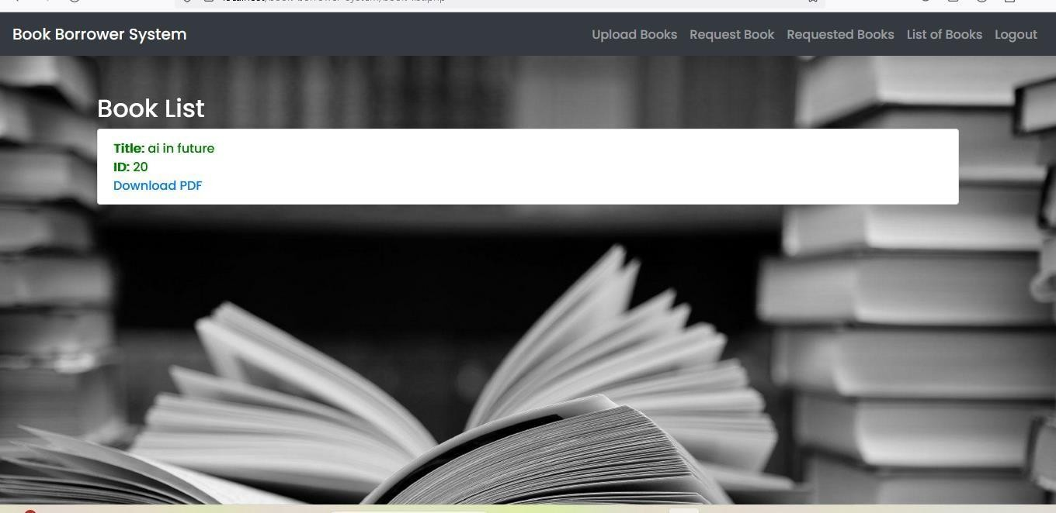
LIST OF BOOKS

Slide 18
CONCLUSION
The Book Lending Website successfully creates an online community for book enthusiasts to share and borrow books, promoting reading and resource sharing. Key functionalities include user registration, book uploading, viewing, borrowing requests, and request management. An alert system keeps users informed about updates. Rigorous testing ensures robustness, reliability, and user-friendliness. The project meets requirements and offers a seamless, engaging user experience, fostering a vibrant community of readers.

